Slide 1


Abstract ID: 3480255, Nov. 1, 2020
AI-Guided Coarse-Graining for More Efficient Modeling of SARS-CoV-2 Spike Glycoprotein
Ziji Zhang¹, David Zhang⁵, Aditya Narayanan⁶, Aditya Ramabadran⁷,
Marcia Simon², Miriam H. Rafailovich³, Yuefan Deng¹, Peng Zhang^{1,4}
Presenter Email: ziji.zhang@stonybrook.edu
¹Department of Applied Mathematics and Statistics, Stony Brook University, Stony Brook, NY, USA; ²School of Dental Medicine, Stony Brook University, Stony Brook, NY, USA; ³Department of Materials Science and Chemical Engineering, Stony Brook University, Stony Brook, NY, USA; ⁴Department of Biomedical Engineering, Stony Brook University, Stony Brook, NY, USA; ⁵Fremont High School, Sunnyvale, CA, USA; ⁶College Station High School, College Station, TX, USA; ⁷Lynbrook High School, San Jose, CA, USA.
Notes:
Hi everyone, my name is Ziji Zhang, a Ph.D. candidate from Stony Brook University Applied Math department. It’s my pleasure today to present our work “AI-Guided Coarse-Graining for More Efficient Modeling of SARS-CoV-2 Spike Glycoprotein” at this MRS 20 Fall meeting. (20’’)

Slide 2

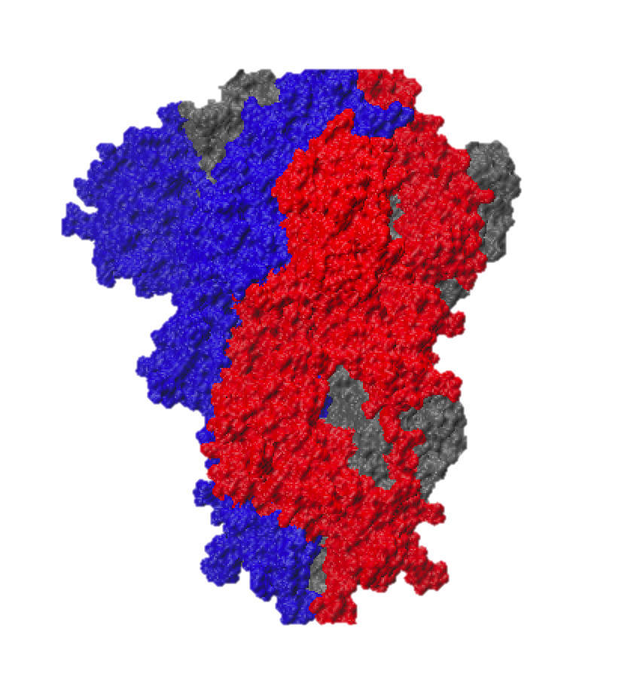
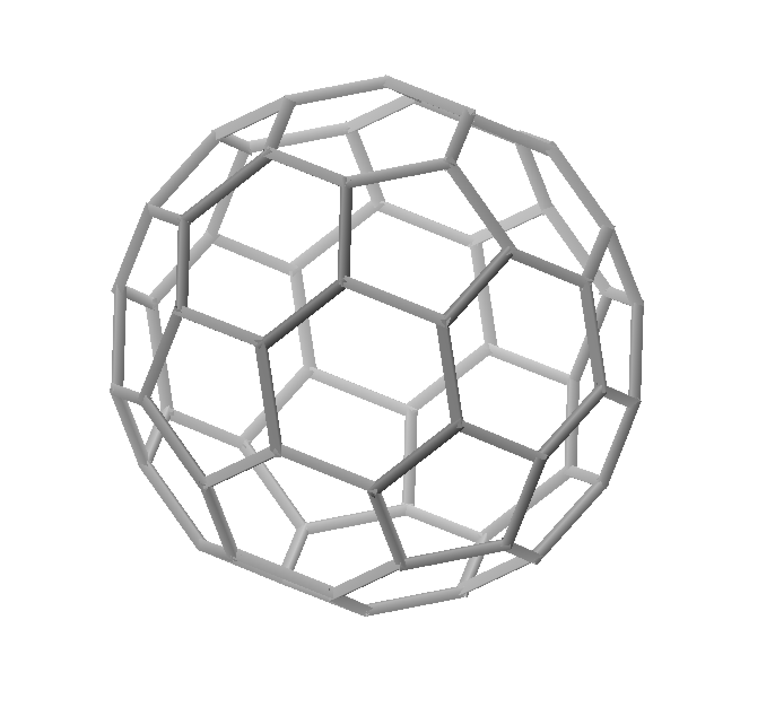
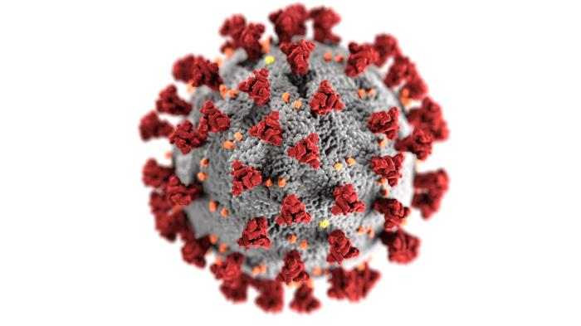
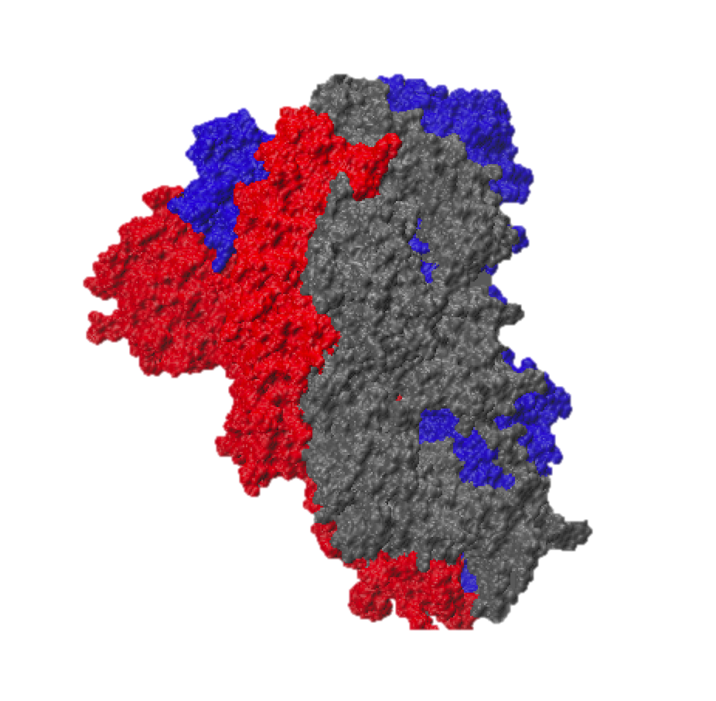
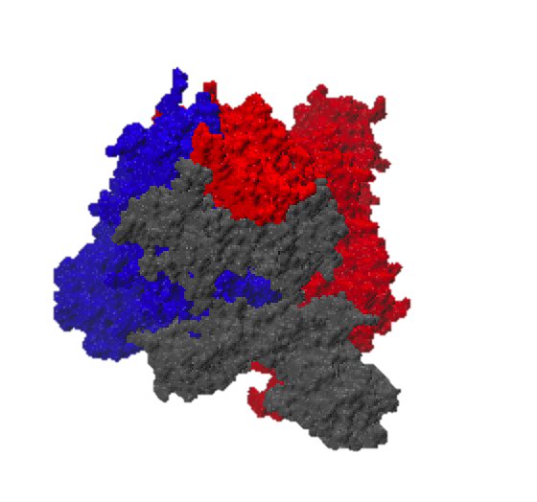
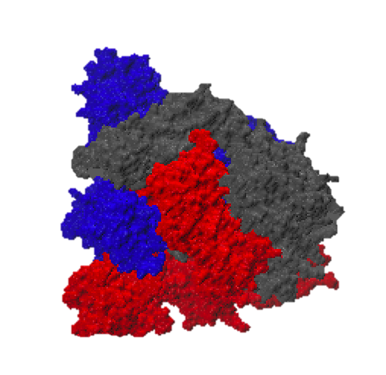
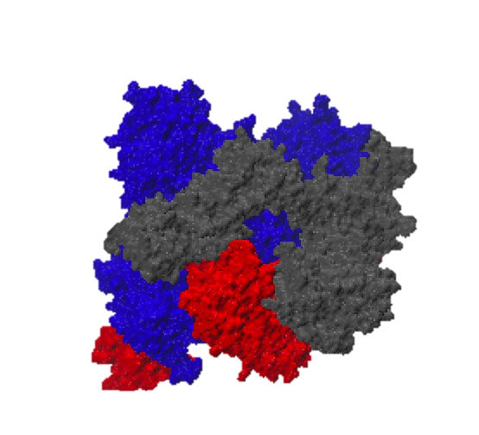
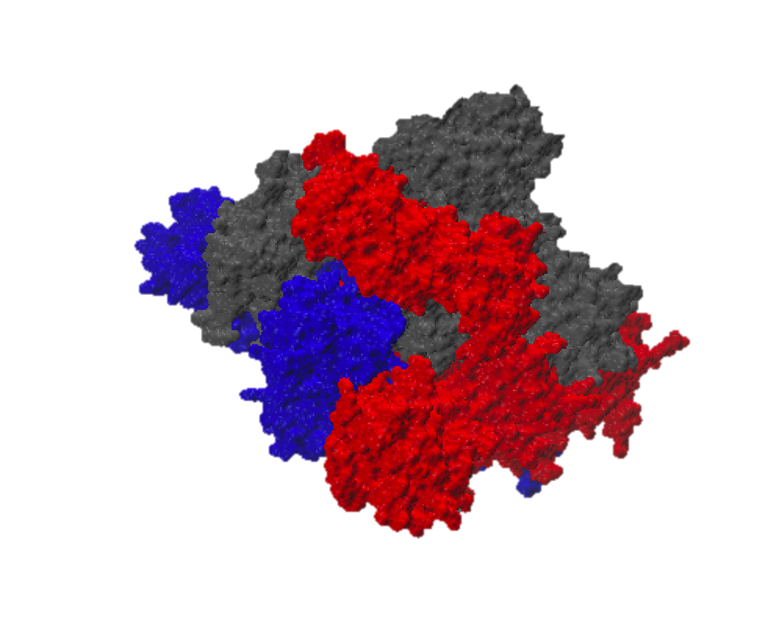
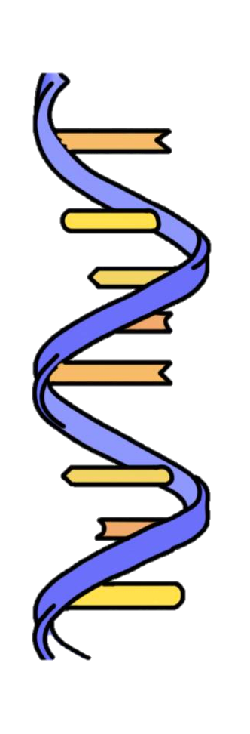
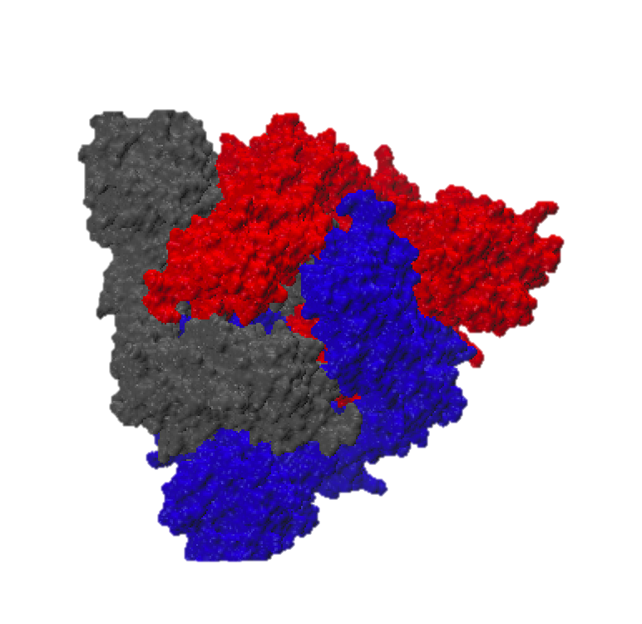
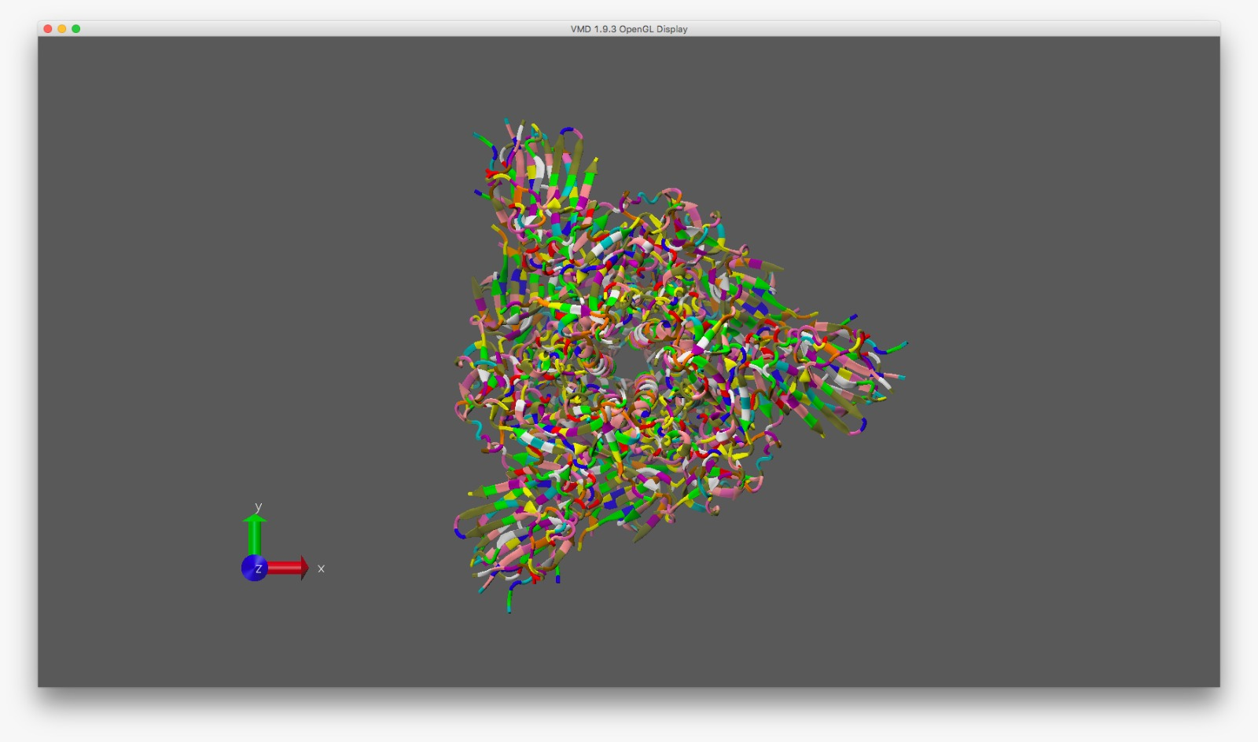
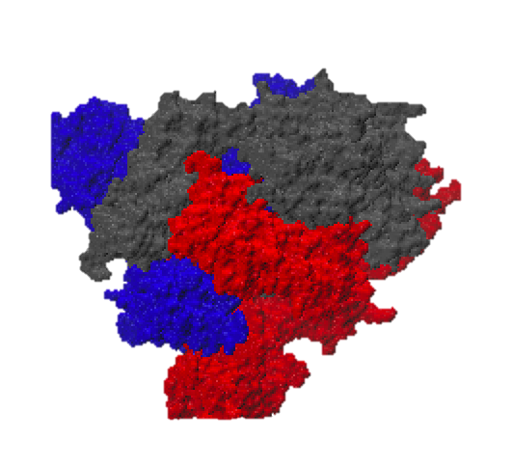
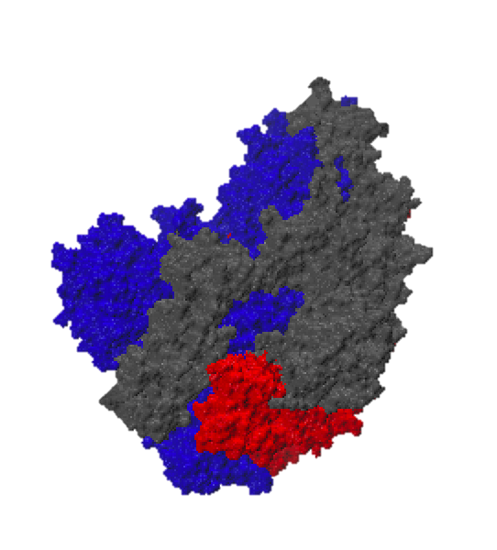
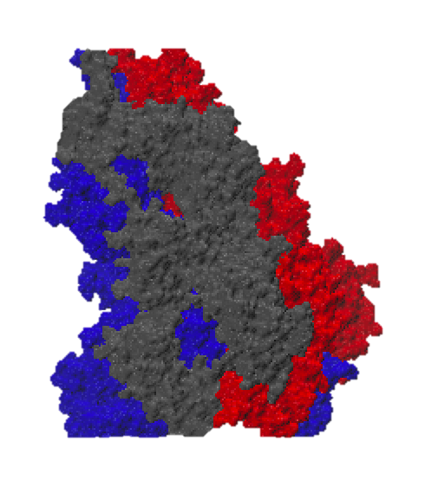

Introduction & Motivation
A novel COVID-19 outbroke and spread worldwide in the past few months.
The outer membrane SARS-CoV-2 spike glycoprotein (S-protein), which is the presumed key receptor for binding to various material substrates, promotes the entry to host cells, and thereby causes infection.^{[1]}
The all-atomic molecular dynamics (MD) simulations that are known to generate reliable results while mitigating potential biological risks for laboratory research are prohibitively expensive in computing time and resources.
Membranous envelope
Spike glycoprotein
The advantage of AI-guided coarse graining approach is to leverage the accuracy of MD and the reduction of unnecessary structural details, to improve the simulation efficiency.
SARS-CoV-2 Model (60x S-Spike)
©Medical Illustration of 2019 Novel Coronavirus from CDC PHIL #23312
PDB code: 6VXX
Atom Count: 23694
Residue Count: 2916
Unique protein chains: 1
All-Atom model
Notes:
As the COVID-19 pandemic spreads worldwide in the past few months, the molecular dynamics research is critical to generate reliable results while avoiding potential biological risks for laboratory research, especially for the spike glycoprotein. The all-atomic molecular modeling, though providing sufficient atomic details, is too time-consuming to reach long time scales in simulations. The advantage of AI-guided coarse graining approach is to leverage the accuracy of molecular dynamics and the reduction of unnecessary structural details, to improve the simulation efficiency. (54‘’)

Slide 3
AI-Guided Coarse-Graining Methods
HPC data-driven atomic MD simulation to provide ground truth
AI-guided methodology to learn the parameters in coarse graining model building
Notes:
Our AI-guided coarse-graining methods use the atomic simulation results from HPC as ground truth, to feed into biomechanics informed neural network. As the outputs, we determined the parameters in coarse-graining force fields and coarse-graining model structures. Without losing significant accuracy, we could speed up the simulation both in spatial and temporal scales. (1’17’’)

Slide 4
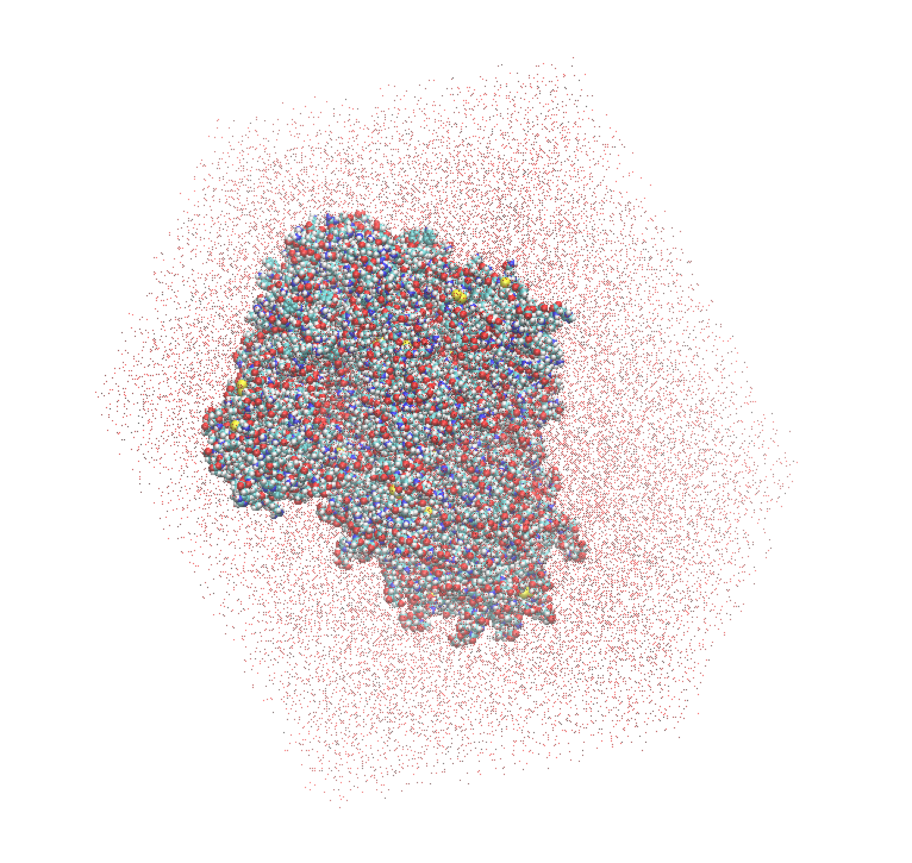
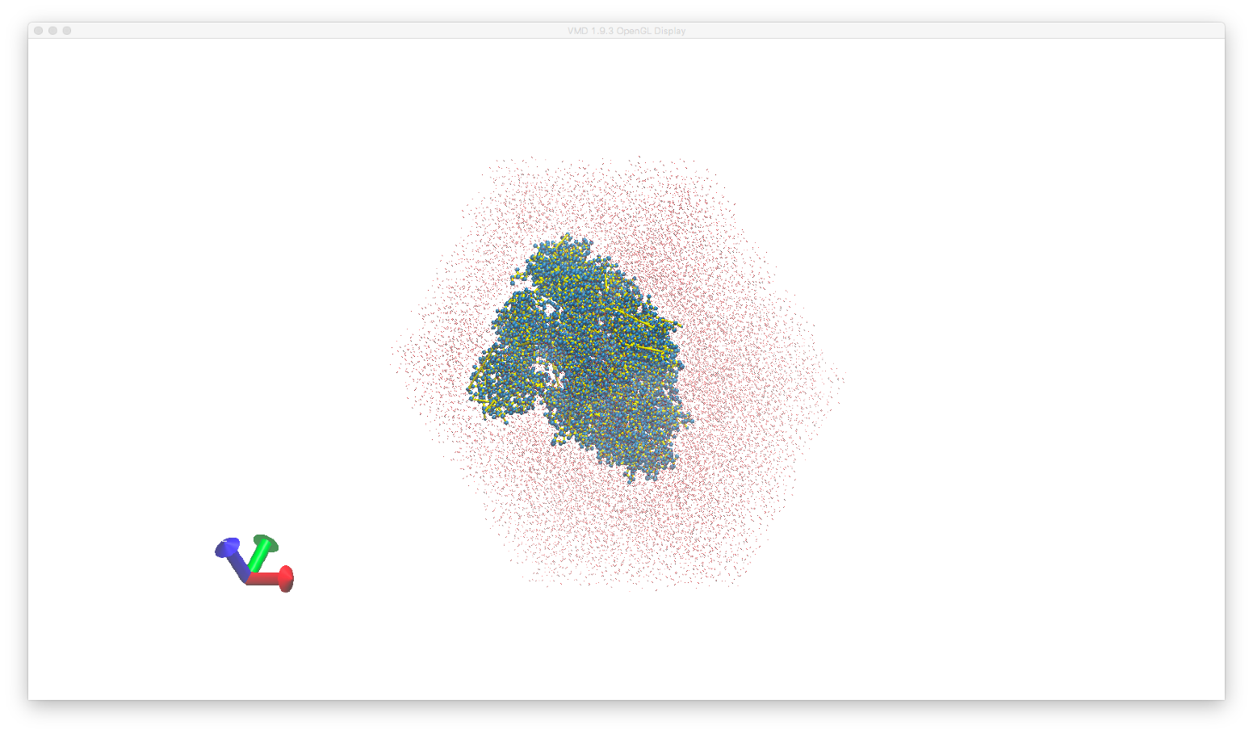
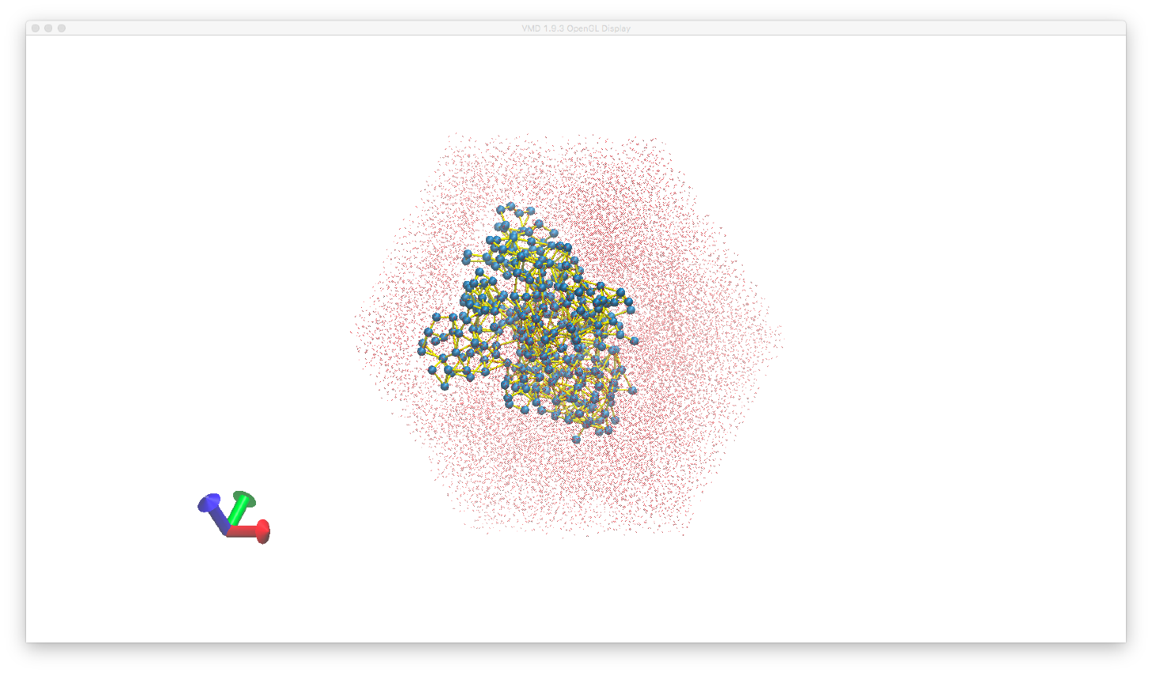
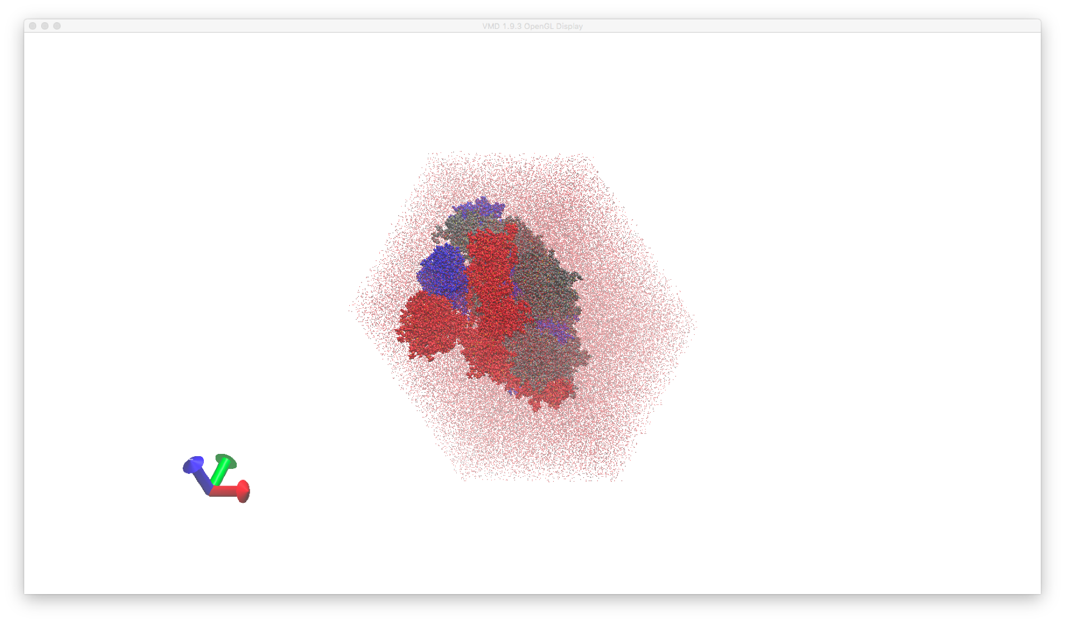
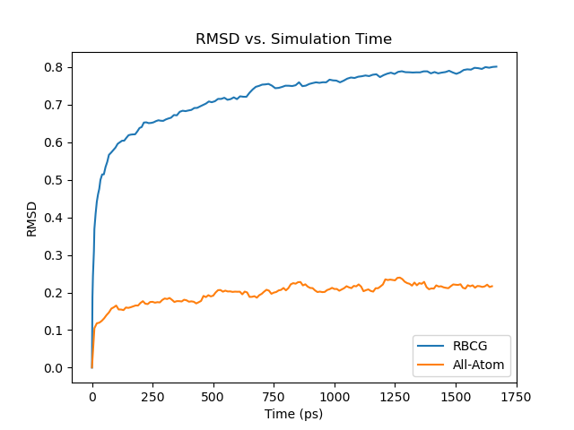
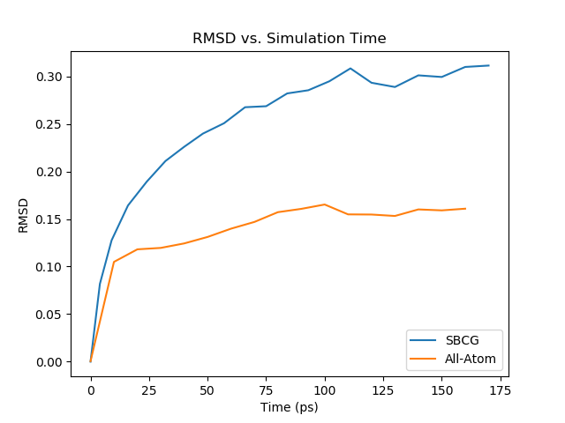
Preliminary Results
Initial models: solvated and ionized coarse-graining system
All-atom: 347,835 particles
CGS^{[2]}: 28,969 particles
CGG^{[3]}: 25,611 particles
Validation: Single S-protein solvated in water with neutralizing ions at 310 K
The RMSD trends were converged which means our CG models have stable structures.
Minimizing the differences of RMSD values by AI enables us to obtain more accurate parameters for longer simulations. (ongoing)
Compare RMSD with atomic-level modeling system
CGS system
CGG system
atomic system
atomic system
Notes:
For preliminary results, we used two different methods to build the initial coarse-grained models and validate them by comparing the RMSD values with the atomic-level system. The RMSD trends were converged which means our CG models have stable structures. And we are minimizing the differences of RMSD values by AI to obtain more accurate parameters for longer simulations. (1’45’’)

Slide 5



Discussions & Future Work
Use Dissipative Particle Dynamics (DPD) for solvent particles spatial scale coarse-graining.
Fine-tune the neural network architectures to optimize the coarse-grained models.
Enabling the study of binding dynamics of the S-protein to various substrates including organic, inorganic materials, and living cells is of great interest in biological science and clinical medicine.
Generalize the methodology to other collection of materials, e.g., human fibrinogen.
References
[1]. Yuan, M., Wu, N.C., Zhu, X., Lee, C.C.D., So, R.T., Lv, H., Mok, C.K. and Wilson, I.A., 2020. A highly conserved cryptic epitope in the receptor binding domains of SARS-CoV-2 and SARS-CoV. Science, 368(6491), pp.630-633.
[2]. Shih, A.Y., Arkhipov, A., Freddolino, P.L. and Schulten, K., 2006. Coarse grained protein−lipid model with application to lipoprotein particles. The Journal of Physical Chemistry B, 110(8), pp.3674-3684.
[3]. Arkhipov, A., Freddolino, P.L. and Schulten, K., 2006. Stability and dynamics of virus capsids described by coarse-grained modeling. Structure, 14(12), pp.1767-1777.
Acknowledgements
• The project is sponsored by the OVPR&IEDM COVID-19 Seed Grant, PIs: P. Zhang, Y. Deng, M. Rafailovich, M. Simon.
• The project is supported by the SUNY-IBM Consortium Award, PI: Y. Deng, Co-I: P. Zhang.
• Part of the simulations were conducted on the AiMOS supercomputer at RPI through an IBM Faculty Award FP0002468 (PI: Y. Deng).
Presenter Email: ziji.zhang@stonybrook.edu
Notes:
This novel methodology could enable the study of spike protein binding dynamics and could be generalized to other materials for example human fibrinogen. Thank you for your time. (2’)

